Slide 1

SIMPLE STYLE THESIS DEFENSE
Here is where your presentation begins

Slide 2
CONTENTS OF THIS TEMPLATE
You can delete this slide when you’re done editing the presentation
FONTS | To view this template correctly in PowerPoint, download and install the fonts we used
USED AND ALTERNATIVE RESOURCES | An assortment of graphic resources that are suitable for use in this presentation
THANKS SLIDE | You must keep it so that proper credits for our design are given
COLORS | All the colors used in this presentation
ICONS AND INFOGRAPHIC RESOURCES | These can be used in the template, and their size and color can be edited
EDITABLE PRESENTATION THEME | You can edit the master slides easily. For more info, click here
For more info: SLIDESGO | SLIDESGO SCHOOL | FAQs
You can visit our sister projects: FREEPIK | FLATICON | STORYSET | WEPIK | VIDEVO

Slide 3
01
02
OBJECTIVES
METHODOLOGY
03
04
RESULTS ANALYSIS
CONCLUSIONS
You can describe the topic of the section here
You can describe the topic of the section here
You can describe the topic of the section here
You can describe the topic of the section here

Slide 4

01
02
03
PRESENTATION
METHODOLOGY
RESULTS
04
05
CONCLUSION
BIBLIOGRAPHY
You can describe the topic of the section here
You can describe the topic of the section here
You can describe the topic of the section here
You can describe the topic of the section here
You can describe the topic of the section here

Slide 5

01
PRESENTATION
You can enter a subtitle here if you need it

Slide 6
INTRODUCTION
Mercury is the closest planet to the Sun and the smallest one in the Solar System—it’s only a bit larger than the Moon. The planet’s name has nothing to do with the liquid metal, since Mercury was named after the Roman messenger god

Slide 7
—SOMEONE FAMOUS
“This is a quote, words full of wisdom that someone important said and can make the reader get inspired.”

Slide 8

A PICTURE IS WORTH A THOUSAND WORDS

Slide 9
01
OBJECTIVES
You can enter a subtitle here if you need it

Slide 10
HYPOTHESIS
THEORY 1
THEORY 2
Earth is the only planet that has life in the Solar System
Venus has a beautiful name, but also high temperatures
Jupiter
30%
Saturn
60%
20%
80%
60%
40%
MERCURY
NEPTUNE
VENUS
MARS
Mercury is the smallest planet
Neptune is far away from Earth
Venus has a very beautiful name
Mars is actually a cold place

Slide 11

A PICTURE ALWAYS REINFORCES THE CONCEPT
Images reveal large amounts of data, so remember: use an image instead of a long text

Slide 12
STUDY OBJECTIVES
MERCURY
VENUS
JUPITER
Mercury is the closest planet to the Sun and the smallest one in the Solar System
Venus has a beautiful name and is the second planet from the Sun
Despite being red, Mars is a cold place. This planet is full of iron oxide dust

Slide 13
STUDY OBJECTIVES
RESEARCH
01
02
ANALYSIS
Jupiter is the biggest planet in the entire Solar System
Mercury is the smallest planet of them all
DATA STUDY
03
04
COMPARISON
Despite being red, Mars is actually a really cold place
Venus is the second planet from the Sun. It’s really hot there

Slide 14
STUDY OBJECTIVES
Despite being red, Mars is a cold place
Earth is the third planet from the Sun
VENUS
01
Venus is the second planet from the Sun
Neptune is very far away from Earth
Saturn is a gas giant and has several rings
MERCURY
02
Mercury is the smallest planet of them all
The Sun is the closest star to us
Ceres is in the main asteroid belt
JUPITER
03
It’s the biggest planet in the Solar System
Pluto is considered a dwarf planet

Slide 15
HYPOTHESIS
MERCURY
Mercury is the closest planet to the Sun and the smallest one in the Solar System
NEPTUNE
It’s the farthest planet from the Sun and the fourth-largest in the entire Solar System

Slide 16

LITERATURE REVIEW
THEORY 1
THEORY 2
Mercury is the closest planet to the Sun and the smallest one in the Solar System—it’s only a bit larger than the Moon
Venus has a beautiful name and is the second planet from the Sun. It’s terribly hot and its atmosphere is extremely poisonous

Slide 17
THEORIES
THEORY 1
THEORY 2
THEORY 3
01
Mercury is the closest planet to the Sun and the smallest one in the Solar System
02
Venus has a beautiful name and is the second planet from the Sun. It’s terribly hot
03
Despite being red, Mars is actually a cold place. The planet is full of iron oxide dust

Slide 18
OBJECTIVES
MERCURY
It’s the smallest planet of them all
MARS
JUPITER
VENUS
Mars is actually a very cold place
Jupiter is the biggest planet of them all
Venus is the second planet from the Sun

Slide 19
INVESTED TIME
40%
20%
25%
15%
JUPITER
MERCURY
MARS
VENUS
Jupiter is the biggest planet in the entire System
Mercury is the smallest planet of them all
Despite being red, Mars is a very cold place
Venus is the second planet from the Sun

Slide 20
PRIMARY OBJECTIVES
JUPITER
NEPTUNE
VENUS
MARS
01
04
Jupiter is the biggest planet of them all
Neptune is very far away from Earth
It’s the second planet from the Sun
Despite being red, Mars is a very cold place
02
03

Slide 21
SCHEDULE
JAN
FEB
MAR
APR
MAY
JUN
PHASE 1
Task 1
Task 2
PHASE 2
Task 1
Task 2

Slide 22
SCHEDULE
1ST PHASE
2ND PHASE
MO
TU
WE
TH
FR
SA
SU
1ST WEEK
MO
TU
WE
TH
FR
SA
SU
2ND WEEK
3RD PHASE
4TH PHASE

Slide 23
SCHEDULE
FEBRUARY
MARCH
APRIL
Jupiter is the biggest planet in the entire Solar System
Venus has a beautiful name, but also very high temperatures
Despite being red, it’s a cold place. It’s full of iron oxide dust
01
02
03

Slide 24

SCHEDULE
MAY
JUNE
Mercury is the closest planet to the Sun and the smallest
Despite being red, Mars is actually a very cold place
RESEARCH COMPLETED
04
05

Slide 25
STUDY PROGRAM
STATUS | DESCRIPTION | STATUS | DESCRIPTION
03/04 | Mercury is the smallest planet of them all | 04/03 | Jupiter is the biggest planet in the Solar System
03/07 | Venus is the second planet from the Sun | 04/09 | Neptune is the farthest planet from the Sun
03/10 | Despite being red, Mars is actually a cold place | 04/11 | The Sun is the star at the center of the Solar System
03/21 | Saturn is a gas giant and has several rings | 04/15 | Earth is the third planet from the Sun and has life

Slide 26
STUDY PROGRAM
 | 1ST WEEK | 2ND WEEK | 3RD WEEK | 4HT WEEK | 5TH WEEK
RESEARCH
ANALYSIS
DATA STUDY
COMPARAISON

Slide 27
METHODOLOGY
RESEARCH
ANALYSIS
DATA STUDY
COMPARISON
Venus has a beautiful name, but also high temperatures
Jupiter is the biggest planet in the Solar System
Despite being red, Mars is actually a cold place
Saturn is composed mostly of hydrogen and helium

Slide 28
METHODOLOGY
RESEARCH
ANALYSIS
DATA STUDY
COMPARISON
Venus is the second planet from the Sun
Jupiter is the biggest planet in the Solar System
Despite being red, Mars is a cold place
Saturn is a gas giant and has several rings

Slide 29
METHODOLOGY
RESEARCH
PROCESS
Jupiter is the biggest planet
Mercury is the smallest planet
Saturn is a gas giant and has rings
IDEA
INCOME
Despite being red, Mars is cold
Venus has a beautiful name
ASPIRATION
GOAL
Earth is a planet that has life
Neptune is far away from Earth

Slide 30
TABLE
 | TEST 1 | TEST 2 | TEST 3 | TEST 4
Describe here your metrics 1
Describe here your metrics 2
Describe here your metrics 3

Slide 31
COMPARISON
 | GOALS | RESULT
1ST PHASE | Mercury is the closest planet to the Sun | Venus is the second planet from the Sun
2ND PHASE | Despite being red, Mars is a cold place | Jupiter is the biggest planet of them all
3RD PHASE | Saturn is composed of hydrogen and helium | Neptune is the farthest planet from the Sun
4TH PHASE | Ceres is located in the main asteroid belt | Earth is the third planet from the Sun

Slide 32
STUDY TIMELINE
Mercury is closest planet to the Sun and the smallest
Despite being red, Mars is actually a very cold place
1ST WEEK
2ND WEEK
3RD WEEK
4TH WEEK
FINISH
Venus is the second planet from the Sun and is terribly hot
Neptune is the farthest planet from the Sun
Saturn is the second-largest planet of them all

Slide 33
AWESOME WORDS

Slide 34
GLOBAL VISION
JUPITER
MERCURY
Jupiter is the biggest planet in the Solar System
Mercury is the smallest planet of them all
MARS
NEPTUNE
Despite being red, Mars is actually a cold place
Neptune is the farthest planet from the Sun

Slide 35
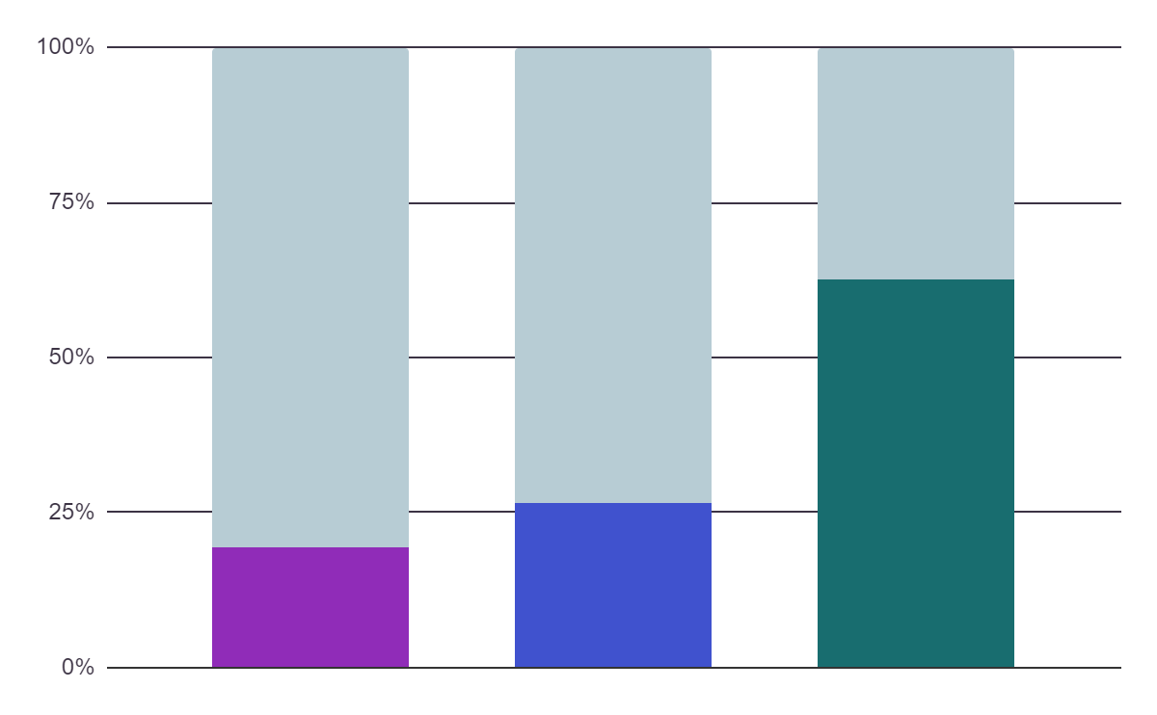
RESULTS ANALYSIS
Mercury
Jupiter
5,408
6,850
Mercury is small
Jupiter is huge
Saturn
9,050
Saturn has rings
If you want to modify this graph, click on it, follow the link, change the data and replace it

Slide 36
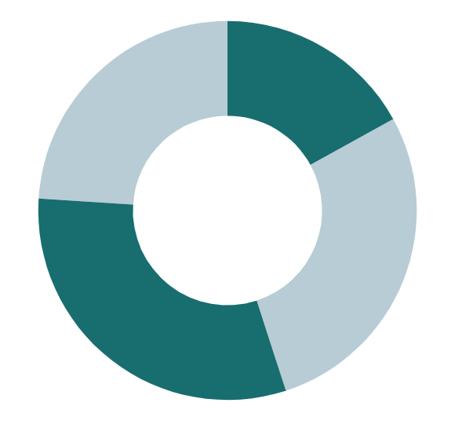
RESULTS ANALYSIS
24%
17%
PHASE 1
PHASE 3
Mercury is small
Jupiter is huge
31%
28%
PHASE 2
PHASE 4
Neptune is far away
Earth harbors life
Follow the link in the graph to modify its data and then paste the new one here. For more info, click here

Slide 37
IMPORTANT PERCENTAGES
25%
70%
90%
JUPITER
MERCURY
VENUS
It’s the biggest planet in the entire Solar System
It’s the smallest planet in the Solar System
It’s the second planet from the Sun

Slide 38
RESULTS ANALYSIS
VENUS
MARS
Venus is the second planet from the Sun
Despite being red, Mars is a cold place
10%
70%
MERCURY
NEPTUNE
Mercury is the smallest planet of them all
Neptune is the farthest planet from the Sun
70%
20%
JUPITER
SATURN
It’s the biggest planet in the Solar System
Saturn is a gas giant and has several rings
50%
30%

Slide 39
RESEARCH RESULTS
MERCURY
JUPITER
VENUS
It’s the smallest planet in the Solar System
It’s the biggest planet in the Solar System
Venus is the second planet from the Sun
20%
50%
75%
Mercury is the closest planet to the Sun
Jupiter doesn’t have a solid surface
Venus has extremely high temperatures

Slide 40
WHOA!
This can be the part of the presentation where you share an interesting anecdote

Slide 41
CONCLUSIONS
1
MERCURY
Mercury is the closest planet to the Sun and the smallest one in the Solar System—it’s only a bit larger than the Moon
2
VENUS
Venus has a beautiful name and is the second planet from the Sun. It’s terribly hot and its atmosphere is extremely poisonous

Slide 42
CONCLUSIONS
20%
35%
65%
50%
JUPITER
MERCURY
VENUS
MARS
It’s the biggest planet in the Solar System
Mercury is the smallest planet in the Solar System
Venus is the second planet from the Sun
Despite being red, it’s actually a very cold place

Slide 43
CONCLUSIONS
200K
175K
40K
135K
Venus has a beautiful name
Saturn has several rings
Jupiter is a gas giant
Mercury is a small planet

Slide 44
PUBLIC SOLUTIONS
JUPITER
40%
MARS
60%
VENUS
20%
MERCURY
75%
Jupiter is the biggest planet of them all
Despite being red, Mars is actually a cold place
Venus is the second planet from the Sun
Mercury is the smallest planet of them all

Slide 45
2,014,300,800
Big numbers catch your audience’s attention

Slide 46
333,000.00
9h 55m 23s
The Sun’s mass compared to Earth’s
Jupiter’s rotation period

Slide 47
OUR SOLUTIONS
MERCURY
VENUS
MARS
JUPITER
SATURN
NEPTUNE
Mercury is the closest planet to the Sun
Venus is the second planet from the Sun
Despite being red, Mars is a cold place
It’s the biggest planet in the Solar System
Saturn is a gas giant and has several rings
Neptune is the farthest planet from the Sun

Slide 48
OUR SOLUTIONS
MERCURY
VENUS
MARS
JUPITER
SATURN
NEPTUNE
Mercury is the closest planet to the Sun
Venus is the second planet from the Sun
Despite being red, Mars is a cold place
Jupiter is the biggest planet of them all
Saturn is a gas giant and has rings
It’s the farthest planet from the Sun

Slide 49
BIBLIOGRAPHIC REFERENCES
AUTHOR (YEAR). Title of the publication. Publisher
AUTHOR (YEAR). Title of the publication. Publisher
AUTHOR (YEAR). Title of the publication. Publisher
AUTHOR (YEAR). Title of the publication. Publisher
AUTHOR (YEAR). Title of the publication. Publisher
AUTHOR (YEAR). Title of the publication. Publisher
AUTHOR (YEAR). Title of the publication. Publisher
AUTHOR (YEAR). Title of the publication. Publisher
AUTHOR (YEAR). Title of the publication. Publisher

Slide 50
BIBLIOGRAPHIC REFERENCES
AUTHOR | TITTLE
NEPTUNE | It’s the farthest planet from the Sun
MERCURY | It’s the smallest planet of them all
MARS | Despite being red, it’s a cold place
SATURN | It’s a gas giant and has several rings
THE SUN | It’s the closest star to Earth
NOTES
Jupiter is the biggest planet in the Solar System. It’s the fourth-brightest object in the night sky. This planet was named after the Roman god of the skies and lightning

Slide 51
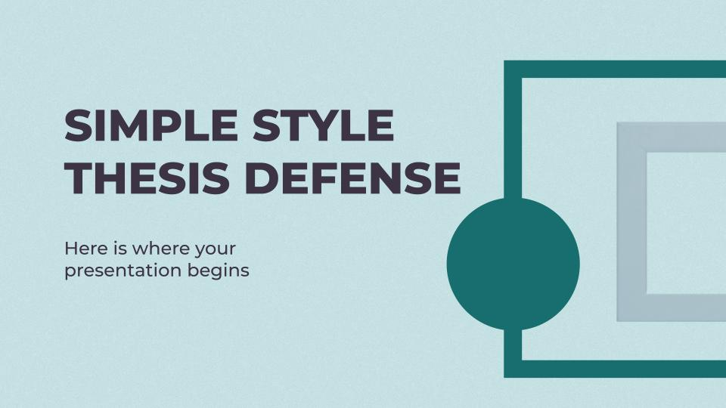
VISIT OUR WEBSITE
You can replace the image on the screen with your own work. Just delete this one, add yours and center it properly

Slide 52
THANKS
Does anyone have any questions? addyouremail@freepik.com +91 620 421 838 yourwebsite.com
Please keep this slide for attribution

Slide 53
ALTERNATIVE RESOURCES
Here’s an assortment of alternative resources whose style fits that of this template:

Slide 54
PREMIUM ALTERNATIVE RESOURCES
Here’s an assortment of alternative resources whose style fits that of this template:
Hand drawn abstract organic shapes background

Slide 55
PREMIUM INFOGRAPHICS
A
Mercury is the closest planet to the Sun
1
%
B
Venus is the second planet from the Sun
2
%
C
Despite being red, Mars is a cold place
3
%
D
Jupiter is the biggest planet in the Solar System
4
%

Slide 56
PREMIUM INFOGRAPHICS
%
%
%
%
Neptune is the farthest planet from the Sun
Saturn is a gas giant and has several rings
Jupiter is the biggest planet of them all
Despite being red, Mars is a very cold place

Slide 57
PREMIUM INFOGRAPHICS
 | PROGRESSION
MARS | Despite being red, Mars is actually a cold place. It's full of iron oxide dust, which gives the planet its reddish cast
VENUS
SATURN
JUPITER
Venus is the second planet from the Sun
Saturn is a gas giant and has several rings
Jupiter the biggest planet of them all

Slide 58
RESOURCES
Did you like the resources on this template? Get them for free at our other websites
PHOTOS
VECTORS
African american woman writing in book at table in office.
Student working with laptop.
Banner exposition event template.
Exposition event template poster.
Exposition event ad poster template Free.

Slide 59
PREMIUM RESOURCES
Did you like the resources on this template? Get them for free at our other websites
PHOTOS:
College students cramming outdoor
High angle graduation cap on pile of books

Slide 60
Instructions for use
In order to use this template, you must credit Slidesgo by keeping the Thanks slide.
You are allowed to:
- Modify this template.
- Use it for both personal and commercial projects.
You are not allowed to:
- Sublicense, sell or rent any of Slidesgo Content (or a modified version of Slidesgo Content).
- Distribute Slidesgo Content unless it has been expressly authorized by Slidesgo.
- Include Slidesgo Content in an online or offline database or file.
- Offer Slidesgo templates (or modified versions of Slidesgo templates) for download.
- Acquire the copyright of Slidesgo Content.
For more information about editing slides, please read our FAQs or visit Slidesgo School:
https://slidesgo.com/faqs and https://slidesgo.com/slidesgo-school

Slide 61
Instructions for use (premium users)
As a Premium user, you can use this template without attributing Slidesgo or keeping the "Thanks" slide.
You are allowed to:
Modify this template.
Use it for both personal and commercial purposes.
Hide or delete the “Thanks” slide and the mention to Slidesgo in the credits.
Share this template in an editable format with people who are not part of your team.
You are not allowed to:
Sublicense, sell or rent this Slidesgo Template (or a modified version of this Slidesgo Template).
Distribute this Slidesgo Template (or a modified version of this Slidesgo Template) or include it in a database or in any other product or service that offers downloadable images, icons or presentations that may be subject to distribution or resale.
Use any of the elements that are part of this Slidesgo Template in an isolated and separated way from this Template.
Register any of the elements that are part of this template as a trademark or logo, or register it as a work in an intellectual property registry or similar.
For more information about editing slides, please read our FAQs or visit Slidesgo School:
https://slidesgo.com/faqs and https://slidesgo.com/slidesgo-school

Slide 62
Fonts & colors used
This presentation has been made using the following fonts:
Montserrat Extra Bold
(https://fonts.google.com/specimen/Montserrat)
Montserrat Medium
(https://fonts.google.com/specimen/Montserrat)
#b7ccd4
#c5e3e1
#3c3344
#4052ce
#902cb8
#186d6f

Slide 63





Storyset
Create your Story with our illustrated concepts. Choose the style you like the most, edit its colors, pick the background and layers you want to show and bring them to life with the animator panel! It will boost your presentation. Go ahead and check out how it works.
Pana
Amico
Bro
Rafiki
Cuate

Slide 64
Use our editable graphic resources...
You can easily resize these resources without losing quality. To change the color, just ungroup the resource and click on the object you want to change. Then, click on the paint bucket and select the color you want. Group the resource again when you’re done. You can also look for more infographics on Slidesgo.

Slide 67
JANUARY
FEBRUARY
MARCH
APRIL
MAY
JUNE
PHASE 1
Task 1
Task 2
PHASE 2
Task 1
Task 2
JANUARY
FEBRUARY
MARCH
APRIL
PHASE 1
Task 1
Task 2

Slide 70
...and our sets of editable icons
You can resize these icons without losing quality.
You can change the stroke and fill color; just select the icon and click on the paint bucket/pen.
In Google Slides, you can also use Flaticon’s extension, allowing you to customize and add even more icons.

Slide 71
Educational Icons
Medical Icons

Slide 72
Business Icons
Teamwork Icons

Slide 73
Help & Support Icons
Avatar Icons

Slide 74
Creative Process Icons
Performing Arts Icons

Slide 75
Nature Icons

Slide 76
SEO & Marketing Icons

Slide 77


